Slide 1

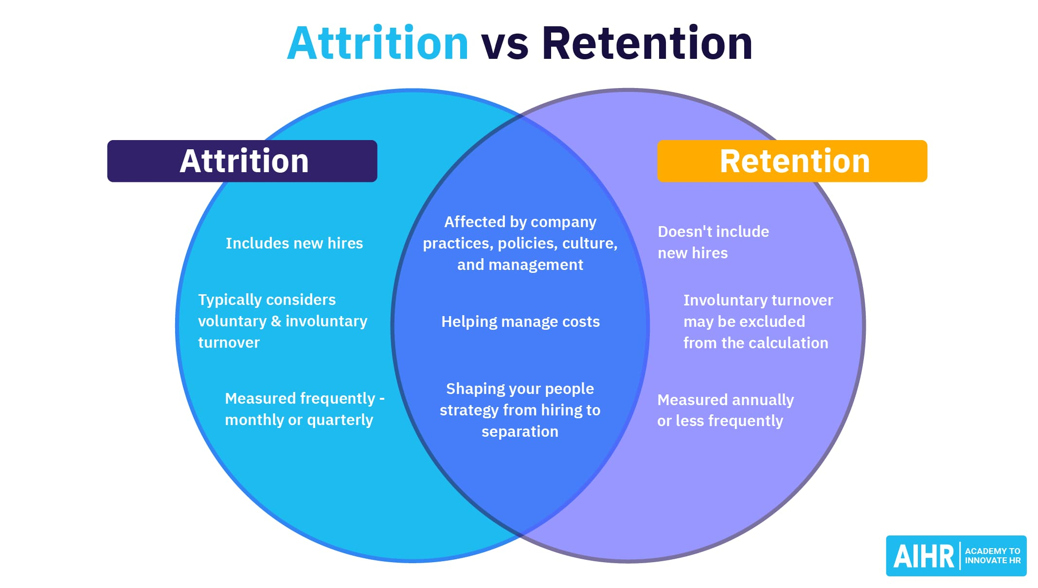
Employee Attrition & Retention
Employee Attrition & Retention
Prepared by :- Abhinav kakkeri
PREPARED BY:- ABHINAV KAKKERI

Slide 2
Introduction
This report provides insights into employee demographics, departmental distribution, job roles, and attrition metrics based on the provided data analytics dashboard. By analyzing these key aspects, organizations can make informed decisions regarding workforce management and retention strategies.

Slide 3
Acknowledgment
I would like to express my sincere appreciation for the effort and expertise that contributed to the development of this Employee Attrition dashboard. The comprehensive visualizations, including the analysis of job satisfaction, departmental distribution, and attrition reasons, provide valuable insights into workforce trends.
Special thanks to the [data analytics team, HR professionals, or any contributors] who played a crucial role in gathering, processing, and visualizing the data, ensuring an accurate representation of employee attrition dynamics.

Slide 4
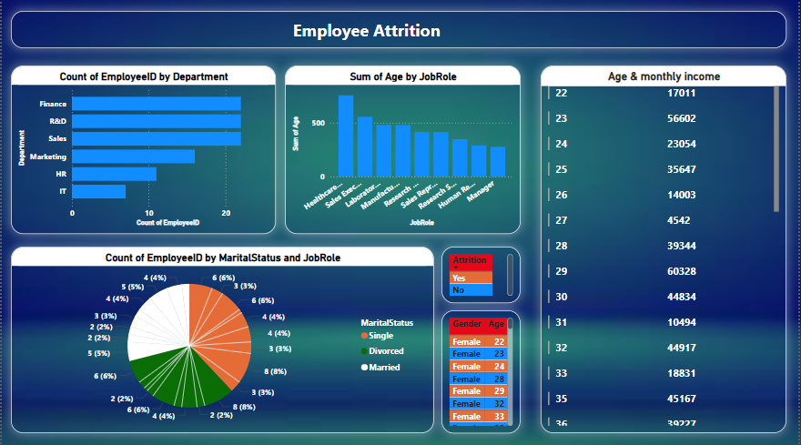
Dashboard

Slide 5
Key Insights
1. Employee Distribution by Marital Status and Job Role:- The pie chart indicates the proportion of employees categorized by marital status and job role.- This segmentation provides insight into the workforce composition and potential correlations between marital status and job roles.####
2. Departmental Employee Count:- A bar graph illustrates the number of employees within different departments.- Identifying departments with higher or lower employee concentrations can be useful in evaluating resource allocation and department-specific retention concerns.

Slide 6
Key Insights
3. Age Distribution by Job Role:- The bar graph shows the total age sum categorized by job role.- It helps in assessing the age diversity within different job roles, which may influence succession planning and experience-driven decision-making.####
4. Age & Monthly Income Analysis:- The table presents a breakdown of employees' age alongside their corresponding monthly income.- This analysis aids in understanding income disparities and whether age plays a significant role in salary distribution.####
5. Employee Attrition Metrics:- The "Employee Attrition" section contains various relevant metrics.- Organizations can assess attrition trends by department, job role, and other factors to identify patterns that may contribute to employee turnover.- This insight assists in developing targeted strategies to improve employee satisfaction and reduce attrition rates.

Slide 7
Conclusion
This dashboard provides valuable insights into workforce distribution and attrition. Organizations can utilize this data to enhance employee retention strategies, optimize departmental resources, and analyze salary distribution trends for improved workforce management.

Slide 8


